Slide 1



Transfer Learning Power-Up
Sean Wong
2025/08/05

Slide 2
Contents
01.
02.
03.
Core Idea
Mechanics
Model Zoo
04.
05.
06.
Real-World Wins
Hands-On Lab
Ethics & Wrap-Up

Slide 3



Core Idea
01

Slide 4

What Transfer Learning Really Is
Definition
Transfer Learning is a technique where a model trained on one task is repurposed on a second related task. This accelerates learning by leveraging pre-existing knowledge.
Analogy
Think of learning a new language. If you already know Italian, learning Spanish becomes easier because some knowledge transfers over. Similarly, pre-trained models provide a head start.
Key Benefits
Transfer Learning saves time, reduces data requirements, and lowers computational costs. It makes advanced AI accessible to small teams and educators with limited resources.

Slide 5



Ideal Conditions
Concrete Benefits
Transfer Learning is most effective when you have limited data, the new task is similar to the original task, and you need fast results with minimal compute resources.
It requires less labeled data, trains much faster, achieves higher accuracy, and reduces costs. This makes it a powerful tool for various industries.
Why Reuse Beats Restart

Slide 6
Mechanics
02

Slide 7
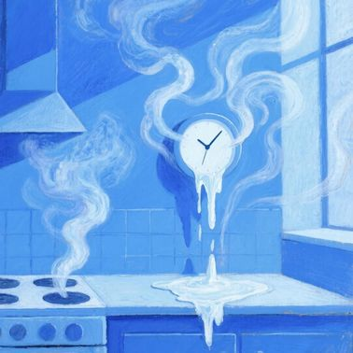


Five-Step Transfer Pipeline
Step 3: Add New Layers
Append new layers tailored to your specific task. For example, add a classifier for image recognition or a decoder for text generation.
Step 1: Load Pre-trained Model
Step 4: Fine-Tune
Start with a pre-trained model like ResNet or BERT. These models have already learned complex patterns from large datasets.
Train the model on your dataset with a low learning rate. Fine-tuning adjusts the model to your specific needs while preserving pre-trained knowledge.
Step 2: Freeze Layers
Optionally freeze early layers to retain general features like edges or language structure. This step is crucial for feature extraction.

Slide 8


Feature Extract vs Fine-Tune
Comparison
Feature extraction freezes the base model and trains only the new layers, offering speed and low compute. Fine-tuning unfreezes layers for higher accuracy but requires more resources.

Slide 9
Model Zoo
03

Slide 10

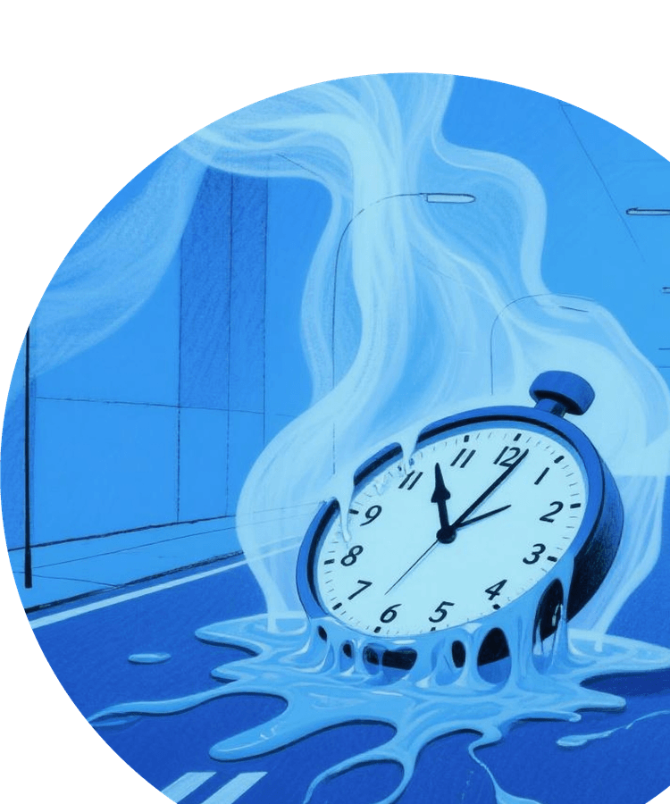
Vision Giants ResNet to EfficientNet
Popular Models
ResNet, VGG, MobileNet, Inception, and EfficientNet are popular vision models. Each excels in different scenarios, from general recognition to on-device speed.
Transferability
These models can be fine-tuned for tasks like medical imaging, agricultural plant disease detection, and industrial quality inspection with minimal data.

Slide 11

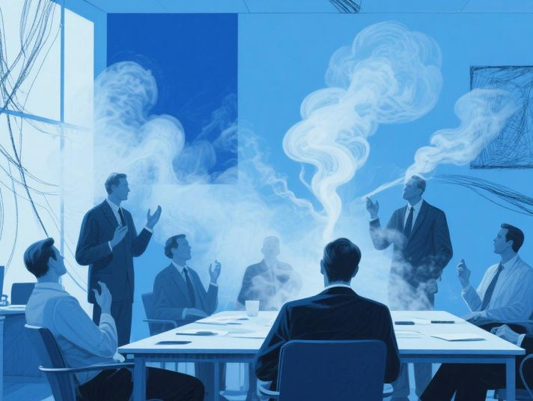
NLP Models
BERT, RoBERTa, GPT, T5, and LLaMA are powerful language models that encode grammar, facts, and reasoning. They can be fine-tuned for tasks like chatbots and essay grading.
Audio Models
Language and Audio Workhorses
Whisper, Wav2Vec, and DeepSpeech offer robust multilingual transcription. These models can be adapted for voice authentication and custom speech recognition.
Versatility
Both NLP and audio models can be repurposed for various tasks with minimal data, making them versatile tools for different industries.

Slide 12
Real-World Wins
04

Slide 13

Healthcare to Agriculture Impact
Impact Across Industries
Transfer Learning empowers radiologists to detect cancers from small X-ray datasets, manufacturers to spot rare defects, educators to auto-grade essays, and farmers to classify plant diseases with minimal data.

Slide 14


Business Value and Accessibility
Business Applications
Customer-support bots fine-tuned on company FAQs, predictive models built by marketing teams with limited datasets, and low-budget startups deploying mobile vision apps showcase transfer learning's business value.
Accessibility
Transfer learning democratizes AI, making it accessible to small teams and educators. It turns AI from a big-tech privilege into an off-the-shelf tool for any domain expert.

Slide 15
Hands-On Lab
05

Slide 16

Image and Text Transfer Labs
Image Classification
Load MobileNet in Google Colab, freeze the convolutional base, add a dense classifier, and retrain on a flower dataset. Achieve over 90% accuracy in minutes.
Text Classification
Import BERT via Hugging Face, attach a classifier, and fine-tune on tweet sentiment data. This demonstrates transfer learning's versatility across domains.
Hands-On Learning
These labs provide practical experience with transfer learning, showing how pre-trained models can be adapted for specific tasks with minimal data.

Slide 17

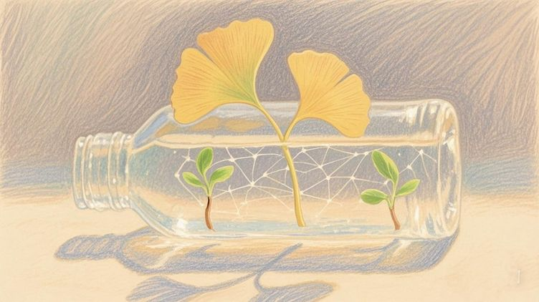
Audio Transcription Creativity
Audio Transcription
Call Whisper to transcribe sample audio. Optionally fine-tune on regional accents to improve accuracy for specific use cases.
Creative Applications
Extend to creative realms by fine-tuning GPT on poetry corpora or teaching object detectors new plant species. Transfer learning accelerates both utility and imagination projects.

Slide 18
Ethics & Wrap-Up
06

Slide 19


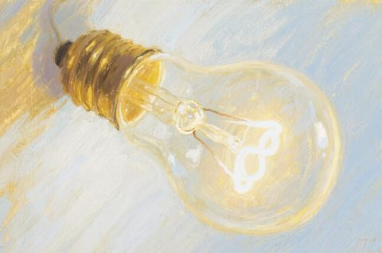
Bias Privacy and Hallucination Risks
Bias
Hallucination
Pre-trained models carry biases from their original datasets. These biases can propagate into new tasks if not addressed.
Language models can generate inaccurate or misleading information. Validate outputs with domain experts to ensure reliability.
Privacy
Mitigation Strategies
Fine-tuning on sensitive data can raise privacy concerns. Ensure data is anonymized and handled securely.
Evaluate models for bias, use diverse fine-tuning data, employ explainability tools, and validate outputs to mitigate risks and build trust.

Slide 20


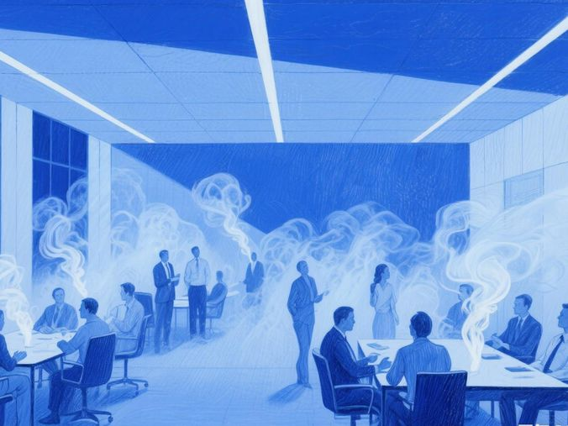
Cheat Sheet and Next Steps
Recap
Transfer learning reuses knowledge from pre-trained models to save time, data, and compute resources. It is applicable in vision, language, and audio domains. Always consider ethical implications.

Slide 21
Thank You
Sean Wong
2025/08/05

